Slide 1

2022 Sponsorship Opportunities
Sponsorship Proposal

Slide 2
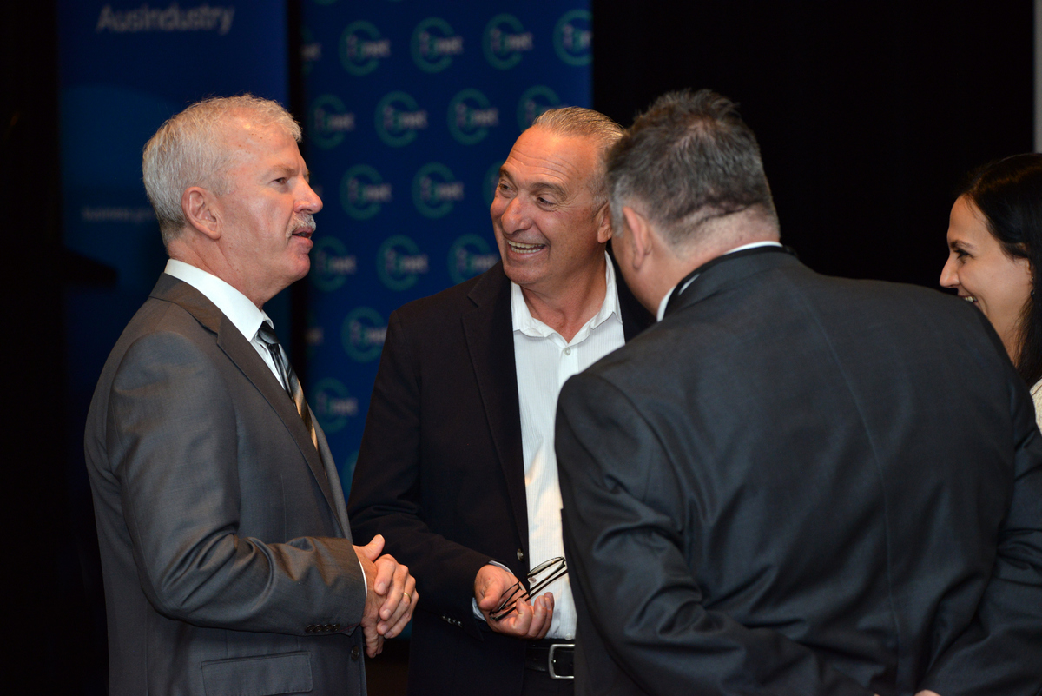
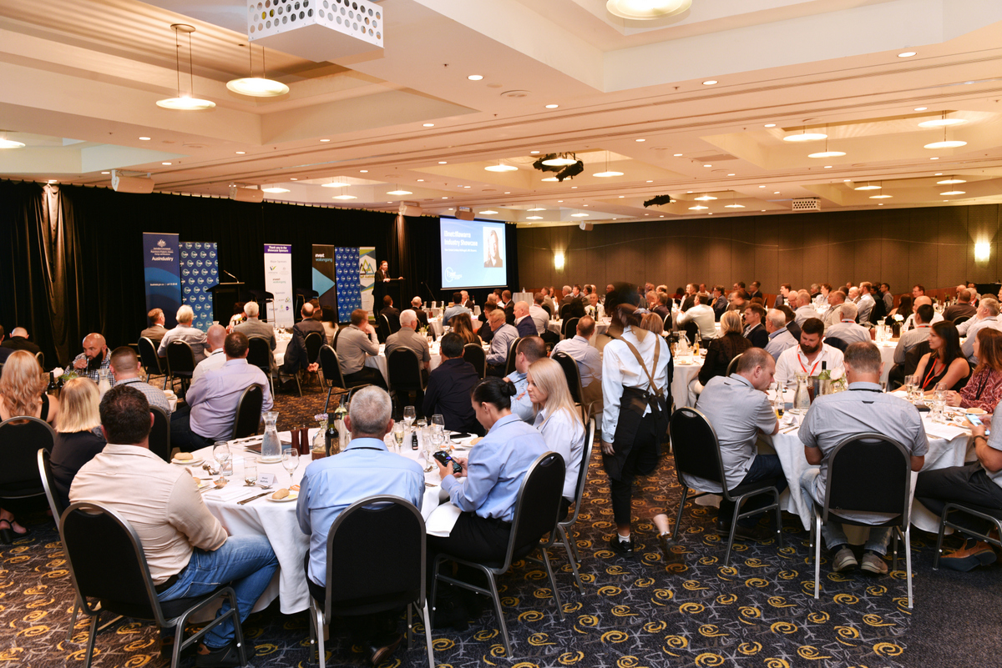
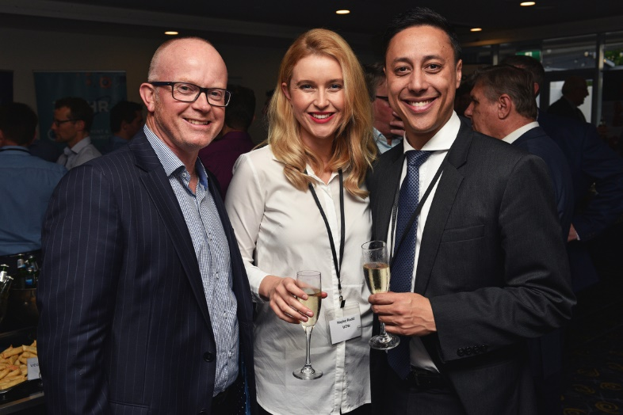

2022 Showcase Overview
Who attends?
Over 150 Industry leaders from across the country and the Illawarra are set to attend this event. This year we are also celebrating 20 years of i3net!
What happens at the event?
Speakers and panellists from Manufacturing, Mining, Energy, Gas, Recycling, Wind, Space, Rail, Defence and Infrastructure Sectors will take the stage, be at your table and in the room ready to hear from you.
You will have meaningful conversations and connections with key decision makers over a drink and a meal.
Schedule
Delegate Industry tour
VIP Cocktail hour
Showcase dinner & breakfast
Expo
Speed networking session

Slide 3
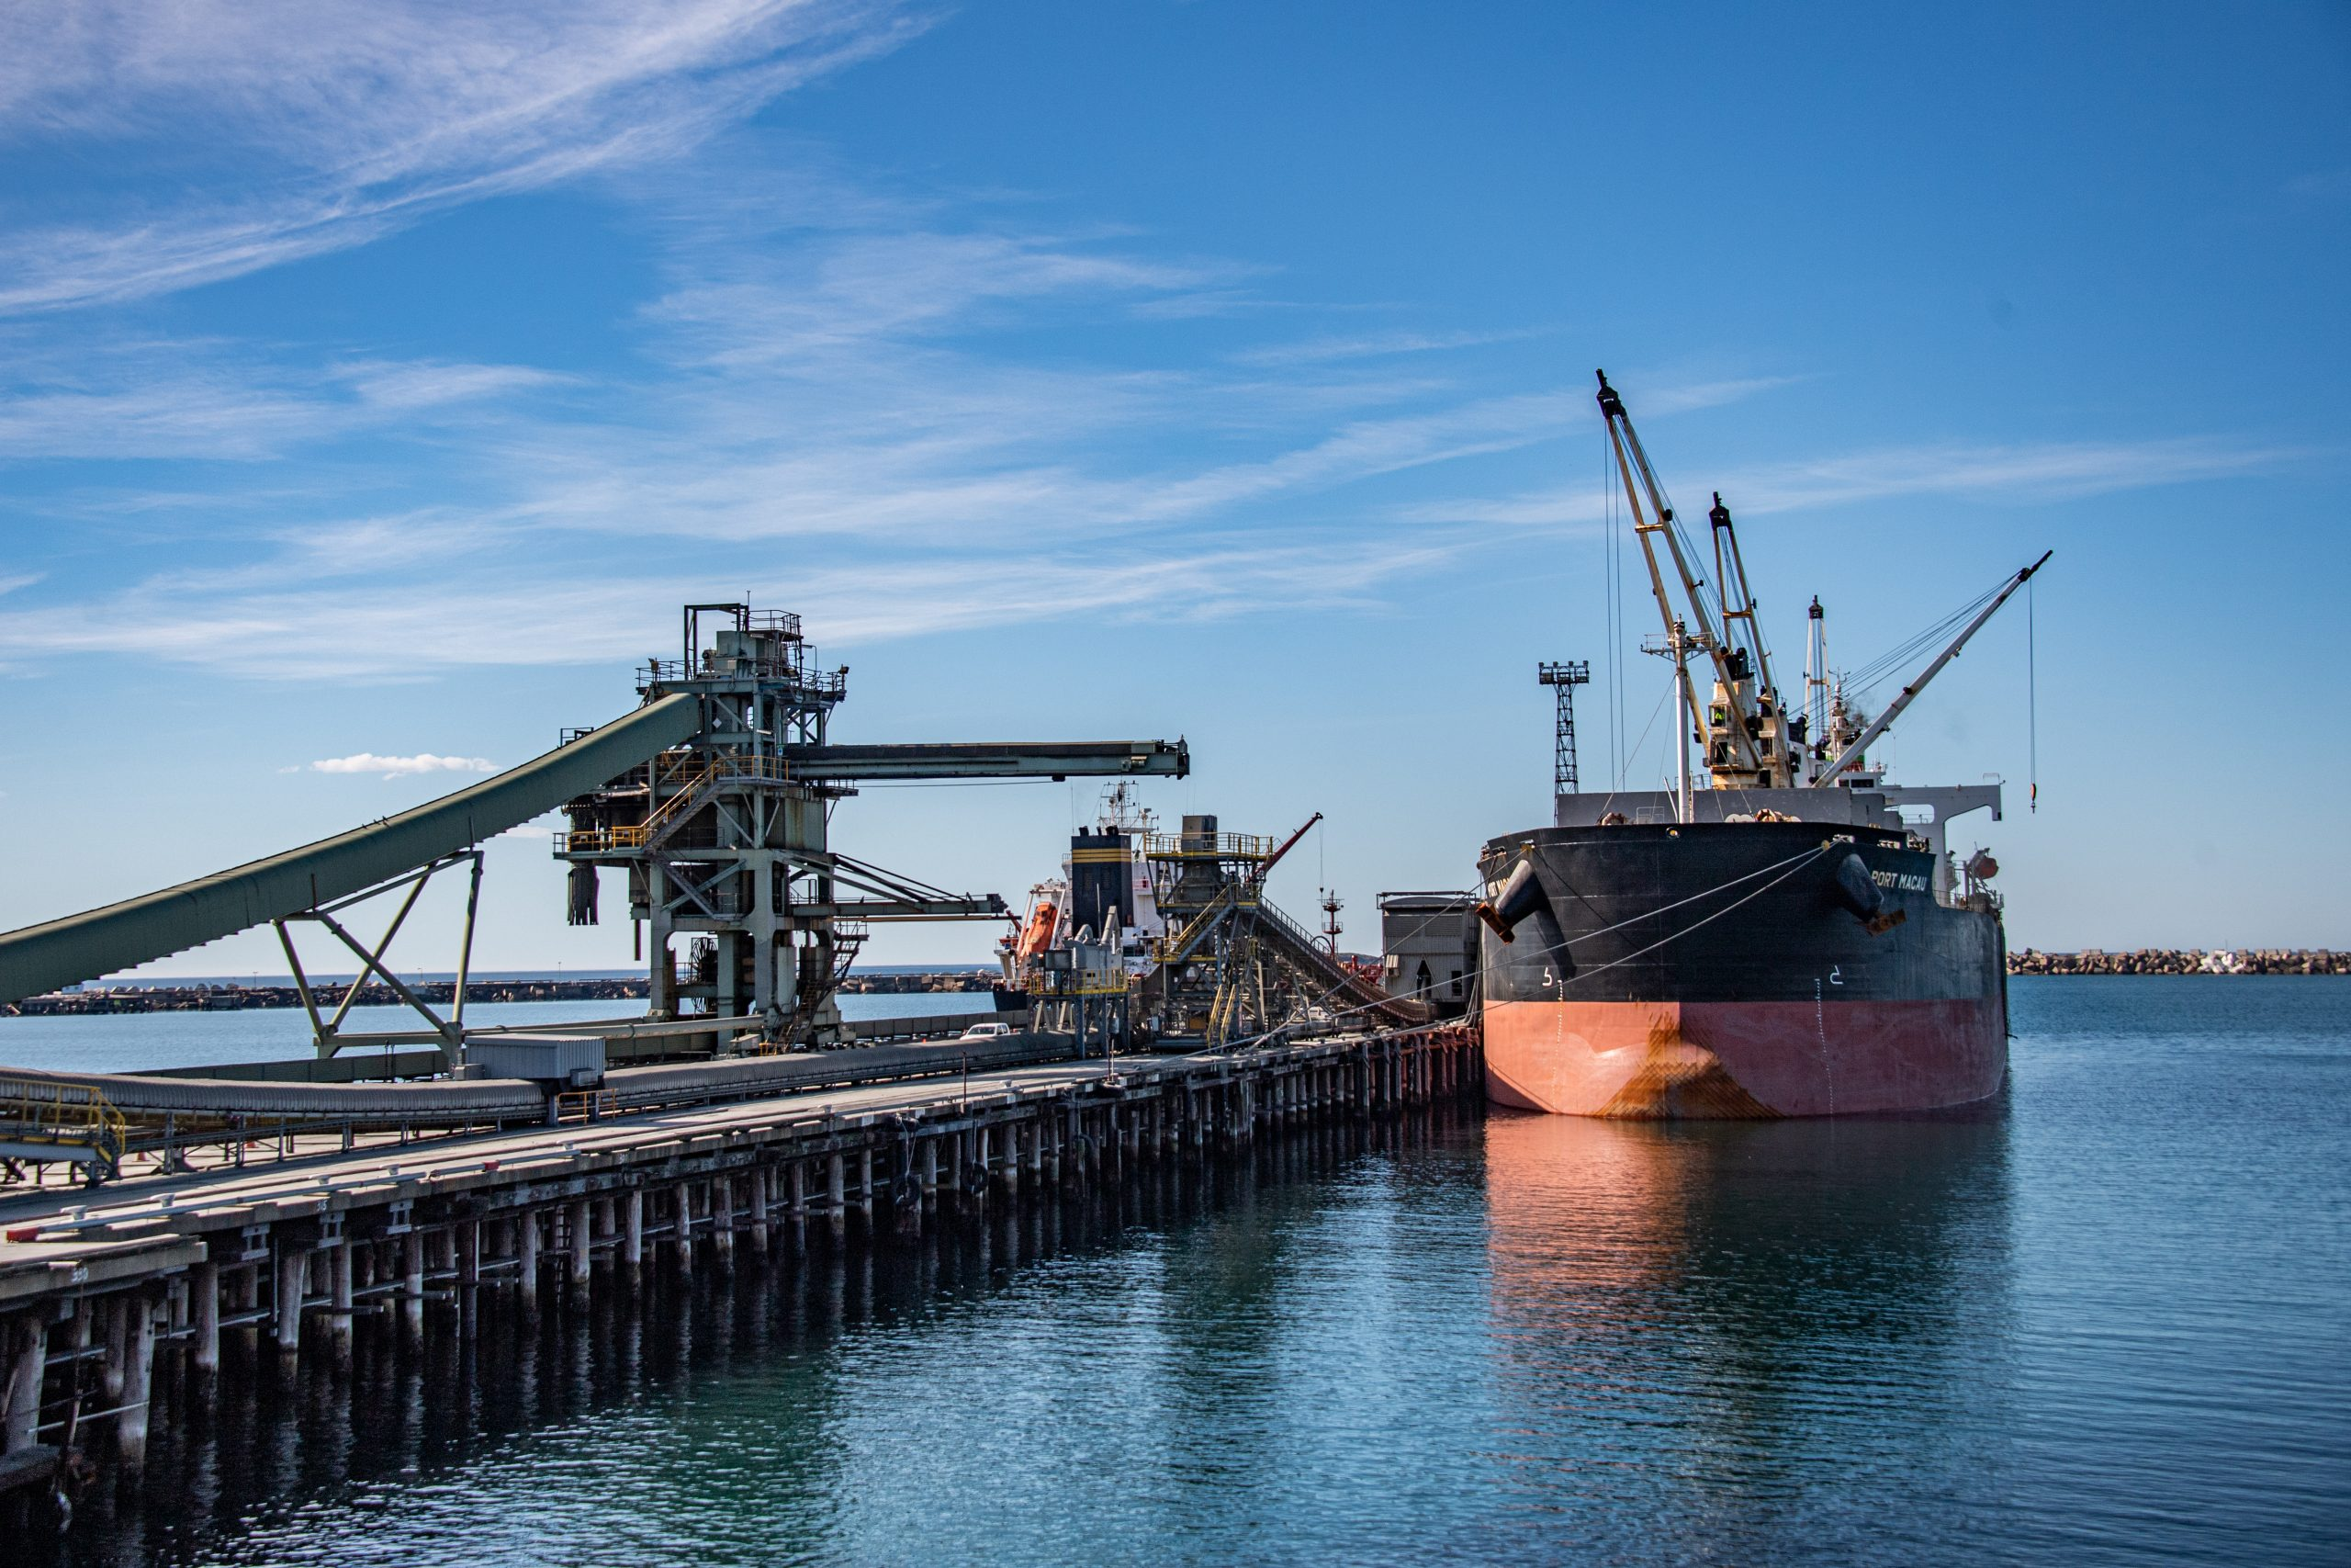

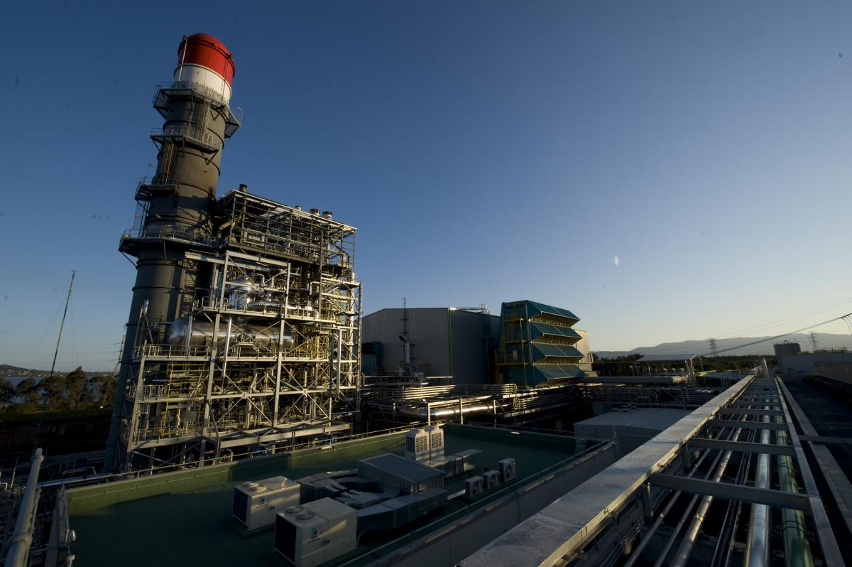
About i3net
i3net, the Illawarra Innovative Industry Network, is a network of industry based companies working from the Illawarra.
From bolts to blast furnaces, from 3D printing to submarines, i3net provides access to the Illawarra’s vast range of manufacturers, engineering service providers and industrial suppliers.
The network was established over 20 years ago to promote the collective capability of industry to local, national and international markets.
The power behind the network is the depth of capability and skills that can be provided by one powerful industry resource.
You can find out more about i3net here: http://i3net.com.au/

Slide 4
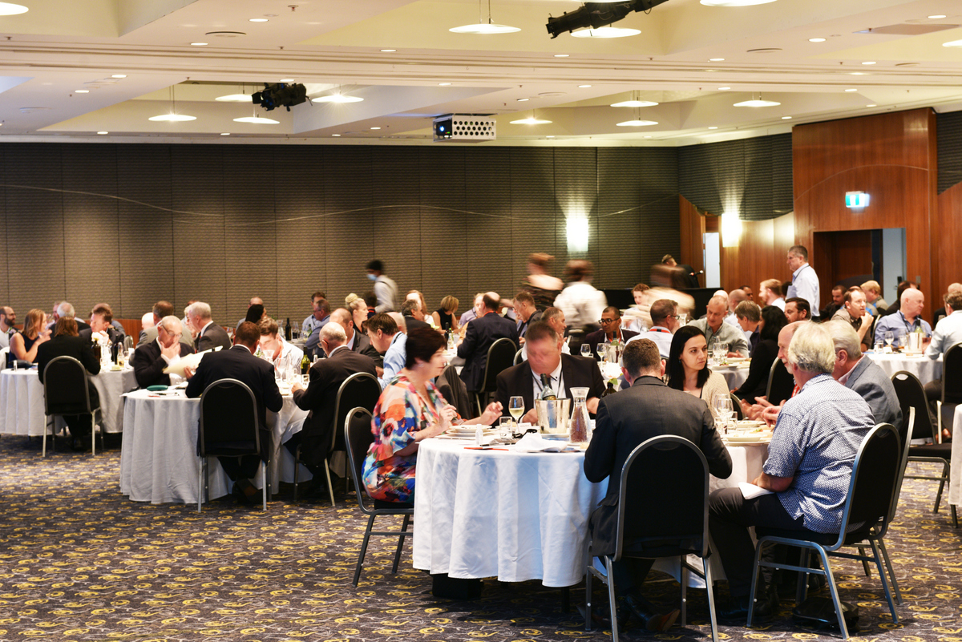
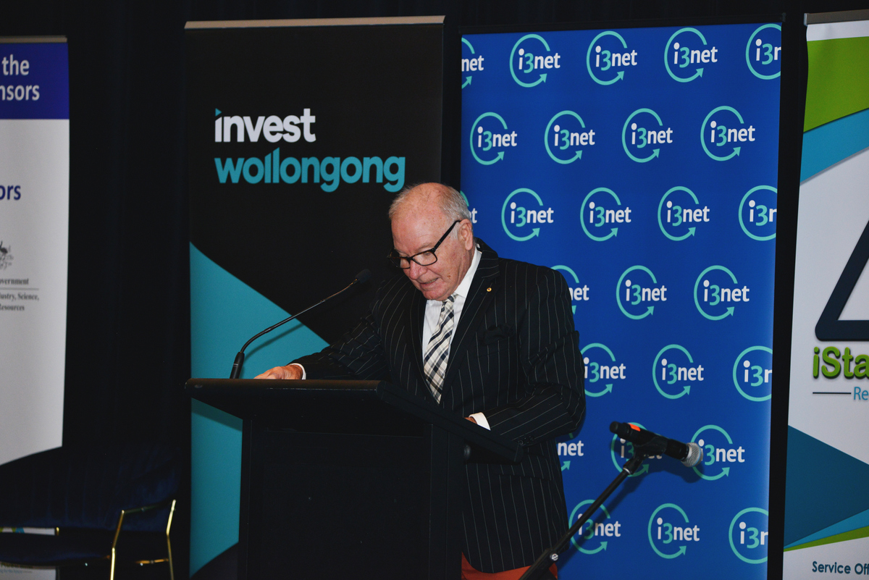
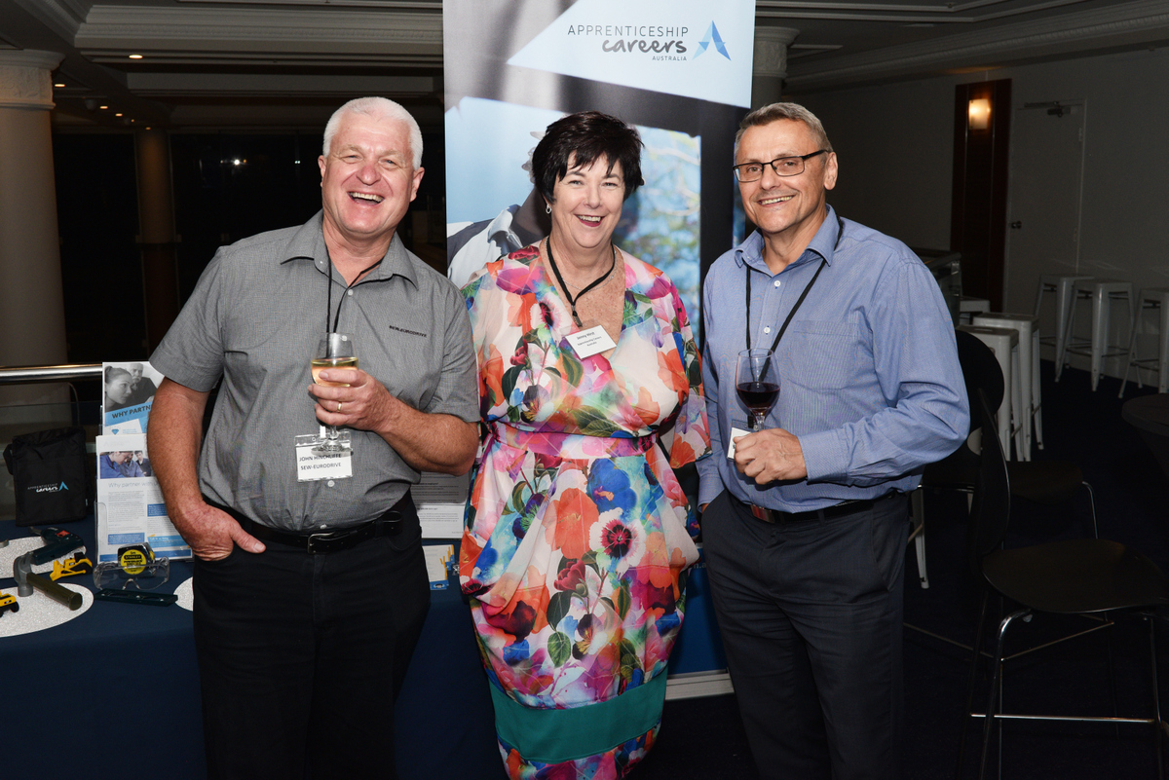
Showcase dinner sponsor
Huge brand visibility!
Benefits
4 x conference registrations (includes tickets to VIP Cocktail Hour, Conference Dinner and Breakfast event).
VIP seating during dinner and breakfast events.
Acknowledgment in conference opening session
Option for Sponsor to give vote of thanks at the end of the event.
1 banner (to be supplied by sponsor) on stage during event (type and size of banner to be determined by i3net).
Opportunity to have a stand at the Expo.
Logo on holding slide prior to sessions.
Mentioned in events comms and social posts.
Mentioned in the Showcase booklet.
Sponsor feature in the post event follow-up email to all attendees.
Investment
$15,000.

Slide 5
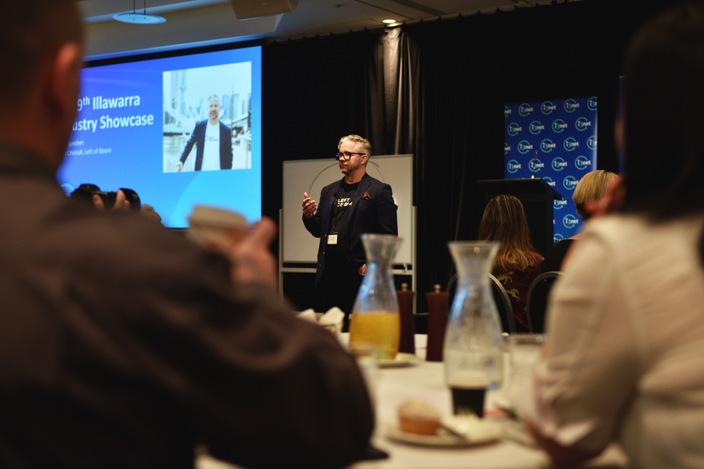
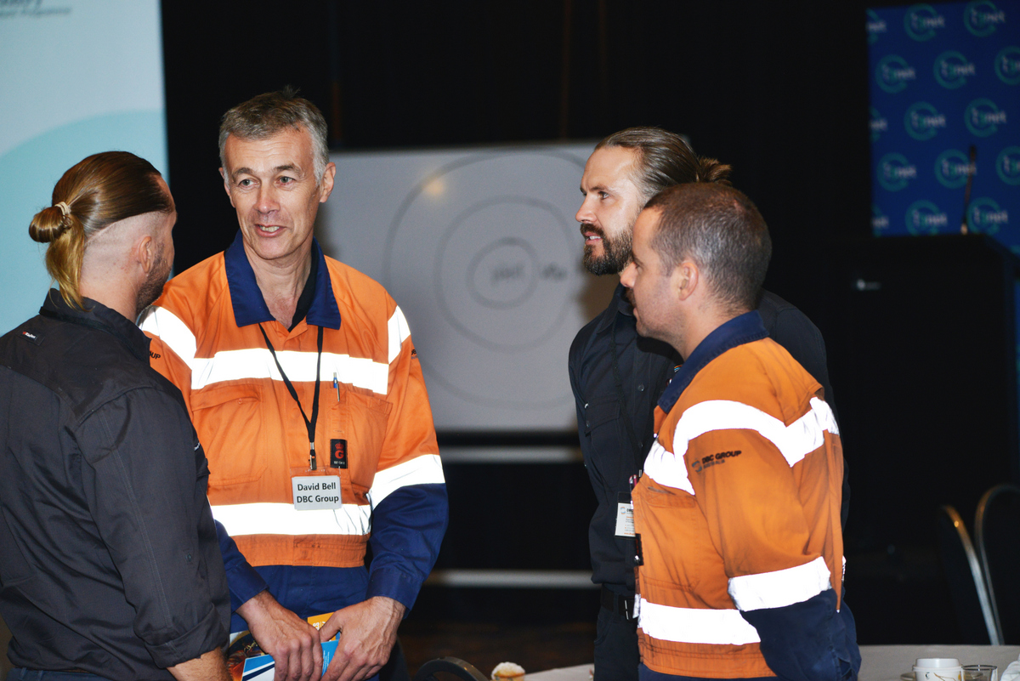
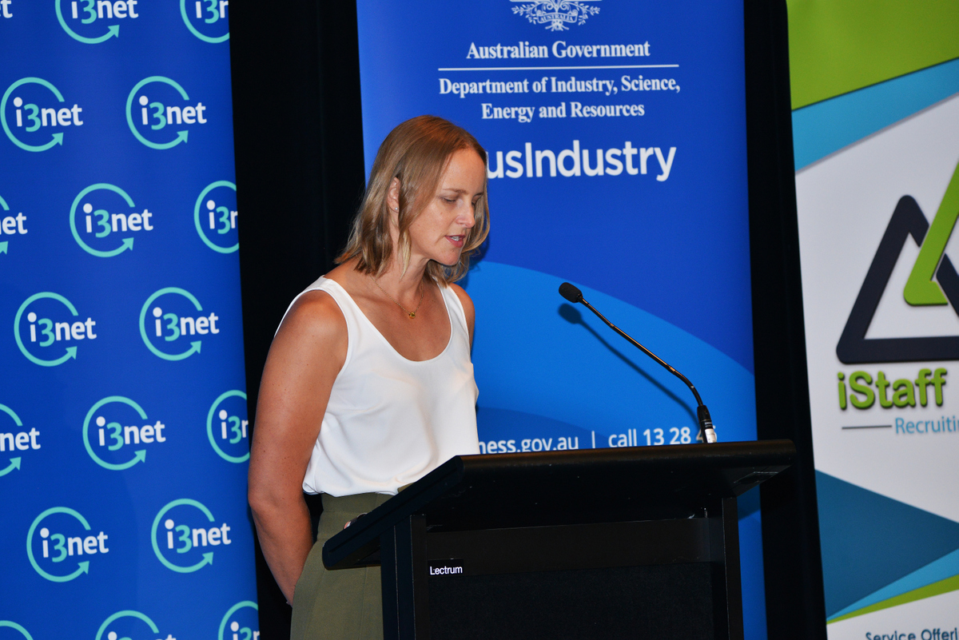
Showcase breakfast sponsor
Huge brand visibility!
Benefits
4 x conference registrations (includes tickets to VIP Cocktail Hour, Conference Dinner and Breakfast event).
VIP seating during dinner and breakfast events.
Acknowledgment in conference opening session
Option for Sponsor to give vote of thanks at the end of the event.
1 banner (to be supplied by sponsor) on stage during event (type and size of banner to be determined by i3net).
Opportunity to have a stand at the Expo.
Logo on holding slide prior to sessions.
Mentioned in events comms and social posts.
Mentioned in the Showcase booklet.
Sponsor feature in the post event follow-up email to all attendees.
Investment
$10,000.

Slide 6


Conference Bag Sponsor Crowd favorite! Fantastic visibility.
Benefits
Exclusive sponsorship of conference bag, for dinner and breakfast.
Option to provide branded delegate bags for the event. Bags to be provided by sponsor.
Bags can be pre-filled with your items
2 tickets to Showcase Dinner and Breakfast.
Company logo on conference website
Company logo in conference booklet
Company logo on sponsor banner.
Investment
$3,000
Only 1 partnership available.
Will sell quickly!

Slide 7

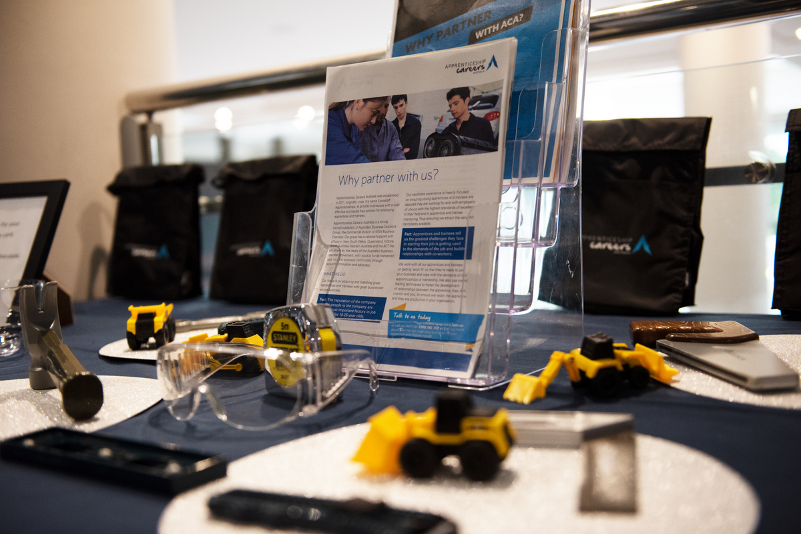
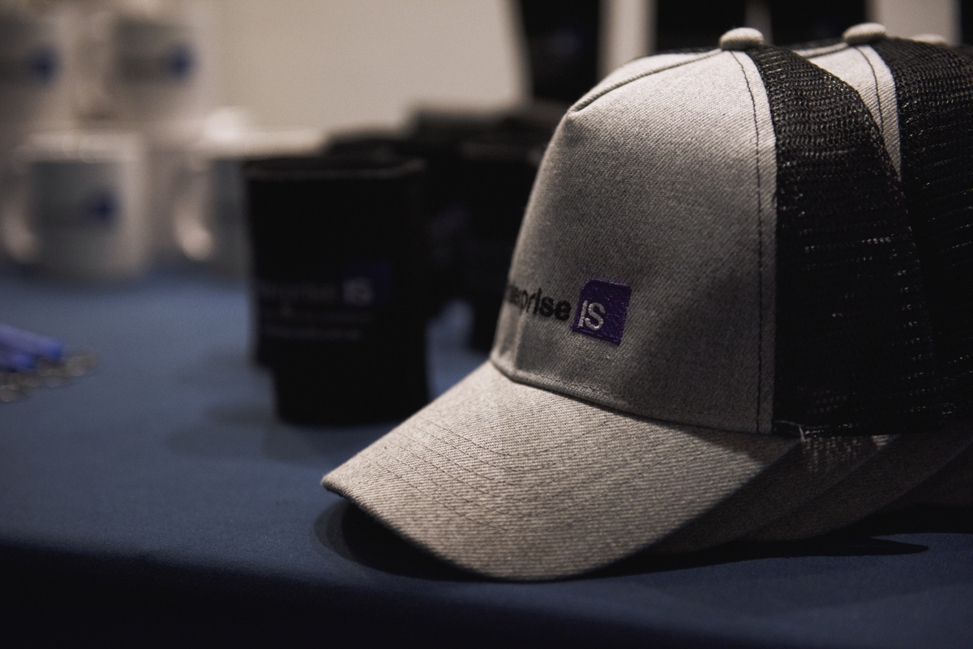
Pen and notepad partner Crowd favorite! Fantastic visibility.
Benefits
Option to provide branded pen and / or notepad for the event. Notepads and pens to be provided by sponsor.
Your Notepads and pens will be placed at each table setting for the dinner and breakfast event.
2 tickets to Showcase Dinner and Breakfast
Company logo on conference website.
Company logo on sponsor banner.
Investment
$3,000.
Popular option due to high visibility.

Slide 8

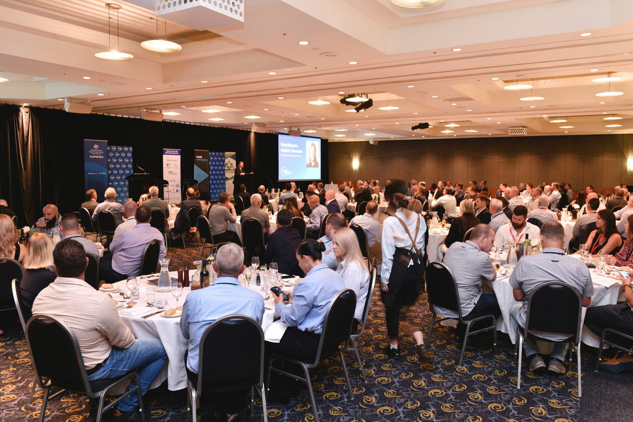

Tech Partner Crowd favorite! Fantastic visibility.
Benefits
• Exclusive sponsorship, one package only
• Sponsor the WIFI and Slido (conference moderating tool) includes card at every seat with WIFI access information on one side and the sponsor’s logo and contact details on the other
• Details displayed in the Dinner and Breakfast slide deck
• Choice of WIFI password
• Company logo in printed program
• Company logo on conference website
Investment
$3,000
Only 1 partnership available.
Will sell quickly!
SOLD!

Slide 9



Water bottle partner Crowd favorite! Fantastic visibility.
Benefits
Option to provide branded water bottles for the event. Bottles to be provided by sponsor.
Water bottles will be placed at each table setting for the dinner and breakfast event.
2 tickets to Showcase Dinner and Breakfast
Organisation logo on conference website
Logo on inside cover of printed program
Logo on sponsor banner
Investment
$3,000
Only 1 partnership available.
Will sell quickly!

Slide 10
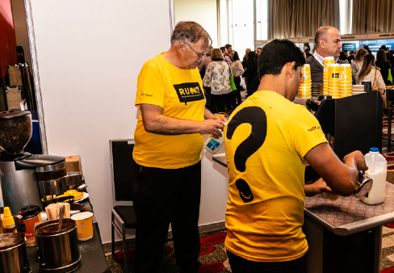

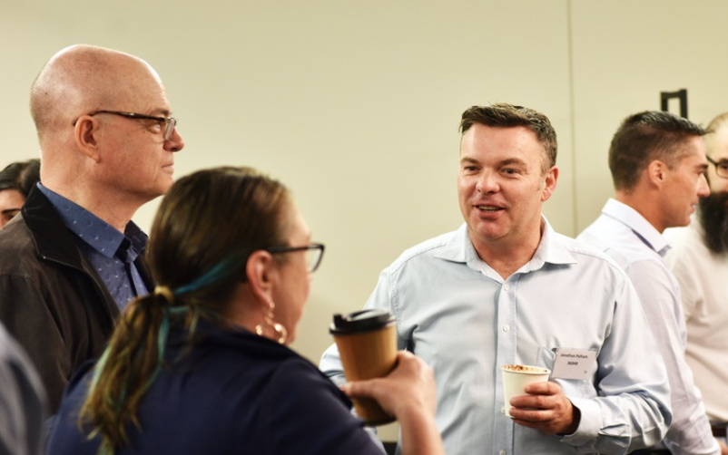
Barista coffee cart sponsor Crowd favorite! Highly visited. Fantastic visibility.
Benefits
Exclusive partner, one package only
Option to brand the coffee cart and surrounding area (coffee cups, signage, tablecloths etc.) To be provided by sponsor)
Option to provide barista apparel (apron, cap, shirt). to be provided by sponsor).
1 table set-up next to cart to display your company information, offers, attendee gifts etc.
2 tickets to Showcase Dinner and Breakfast
Organisation logo on conference website.
Logo on inside cover of printed program.
Logo on sponsor banner.
Investment
$5,000
Only 1 partnership available.
Will sell quickly!
SOLD!

Slide 11
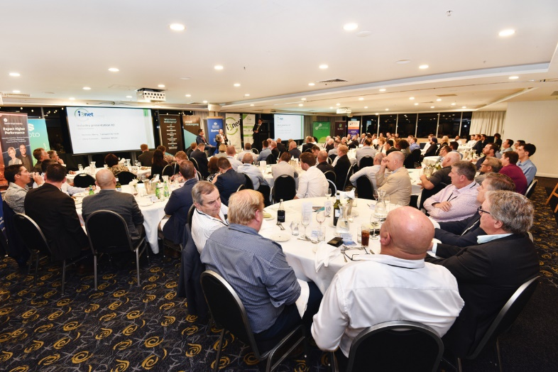
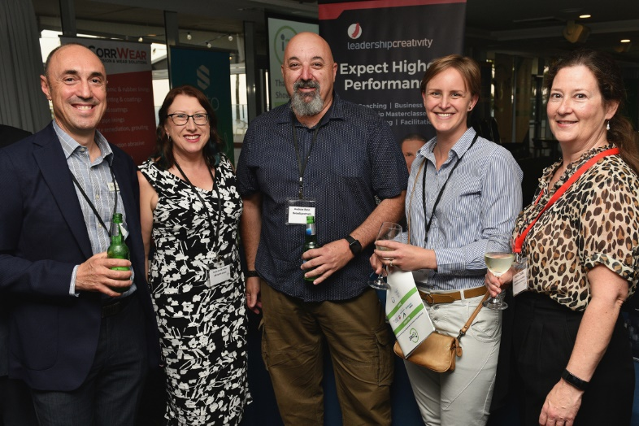
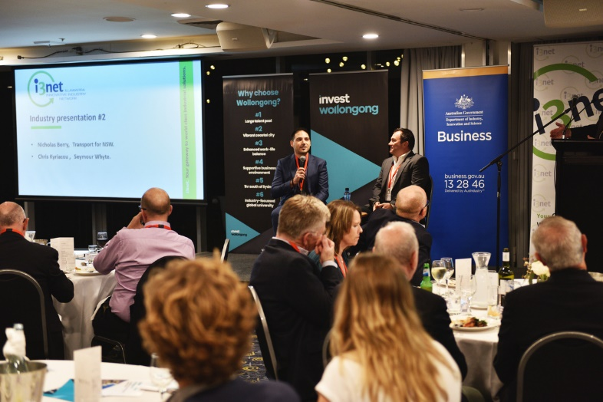
Showcase Sponsorship
Huge brand visibility!
Benefits
2 x conference registrations (includes tickets to VIP Cocktail hour, Conference Dinner and Breakfast event)
Front row seating during dinner event
Acknowledgment in conference opening session
1 banner (to be supplied by sponsor) on stage during Dinner and Breakfast events (type and size of banner to be determined by i3net).
Logo on holding slide prior to sessions
Logo on inside cover of conference booklet
Profile on conference website and printed program.
Investment
$2,000.
Popular option due to high visibility.

Slide 12

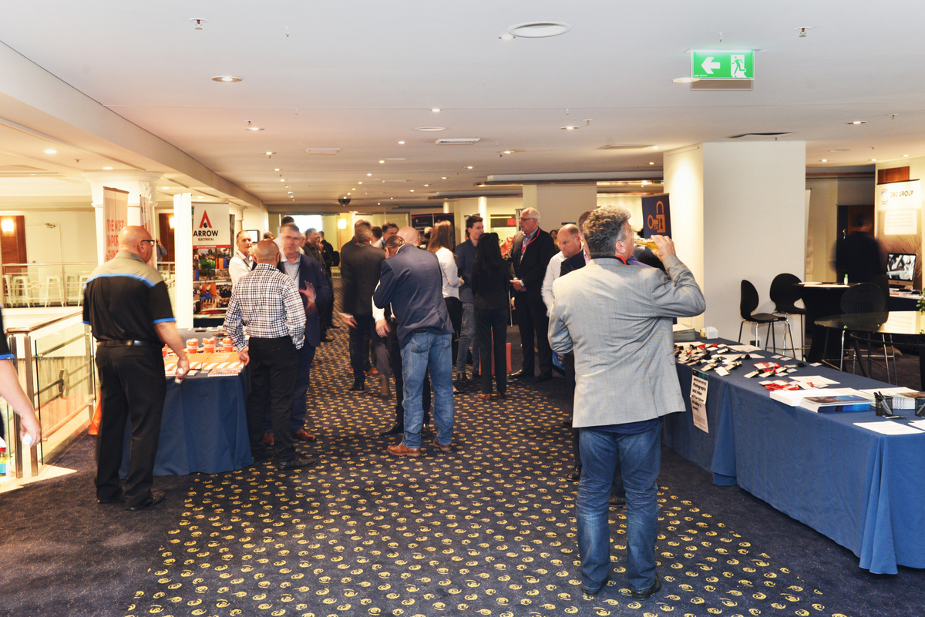

Premium expo position
Note: This offer is only available to i3net members and partners.
Benefits
Double length expo position
Huge brand visibility
Only two premium expo positions available.
Investment
$2000

Slide 13
Expo position
Note: This offer is only available to i3net members and partners.
Benefits
Huge brand visibility
Investment
$1,000

Slide 14
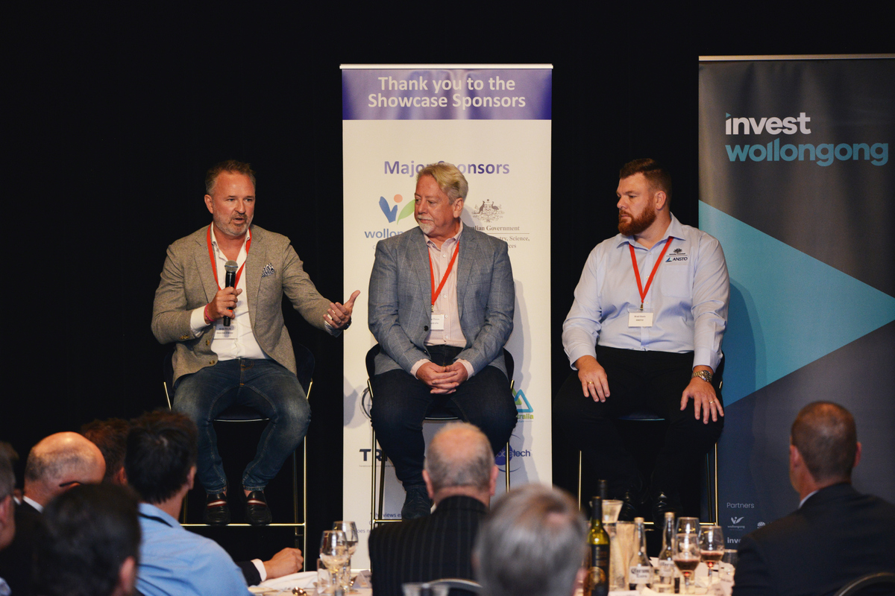

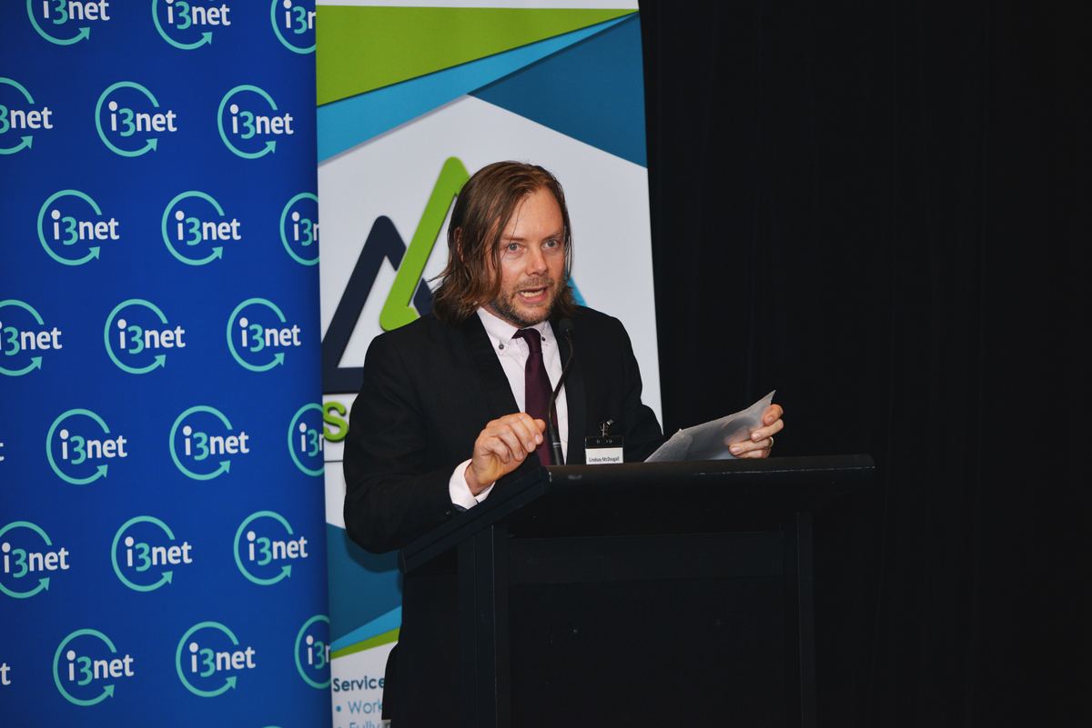
MC a panel session
Get visibility for your business and host one of our informative panels. Choose from the:
Defence Panel
Major Projects Panel
Energy Panel
Investment
$2000

Slide 15
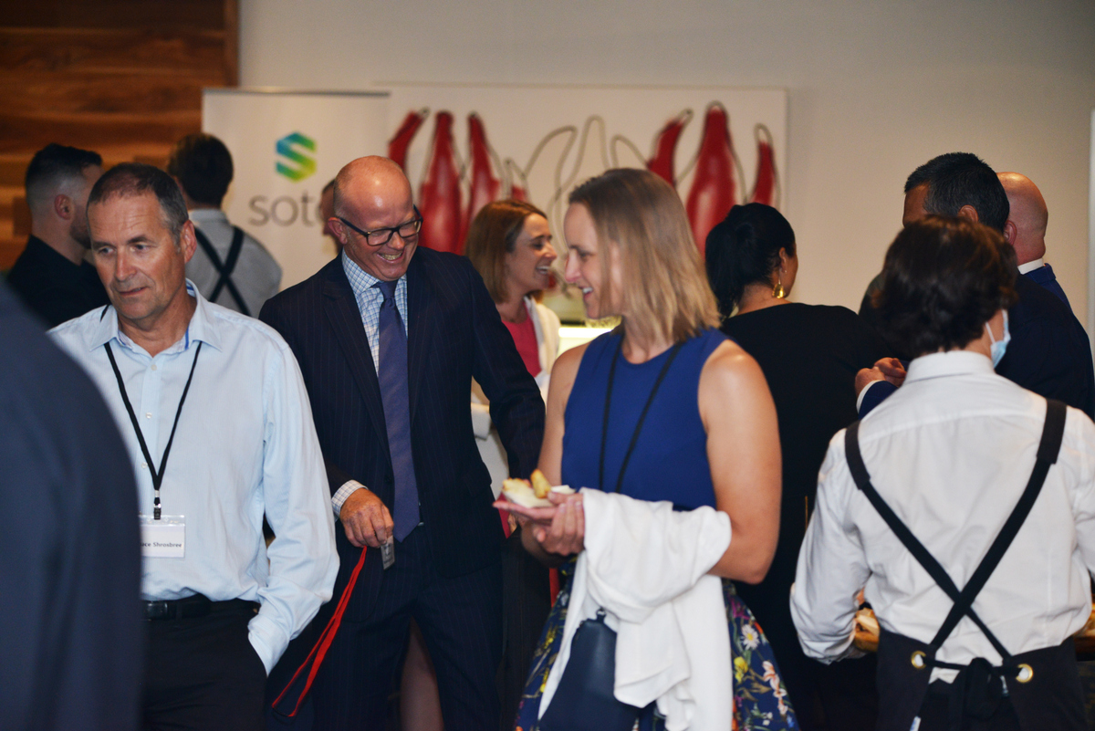
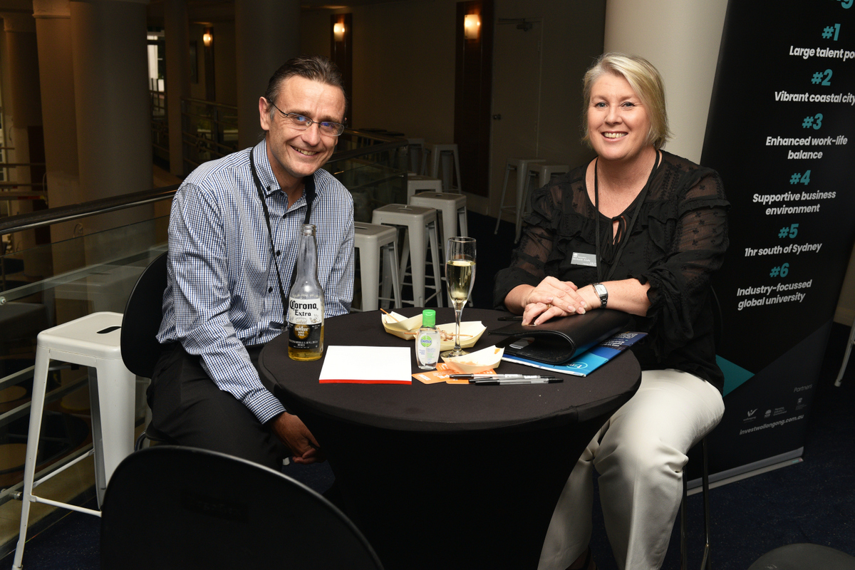
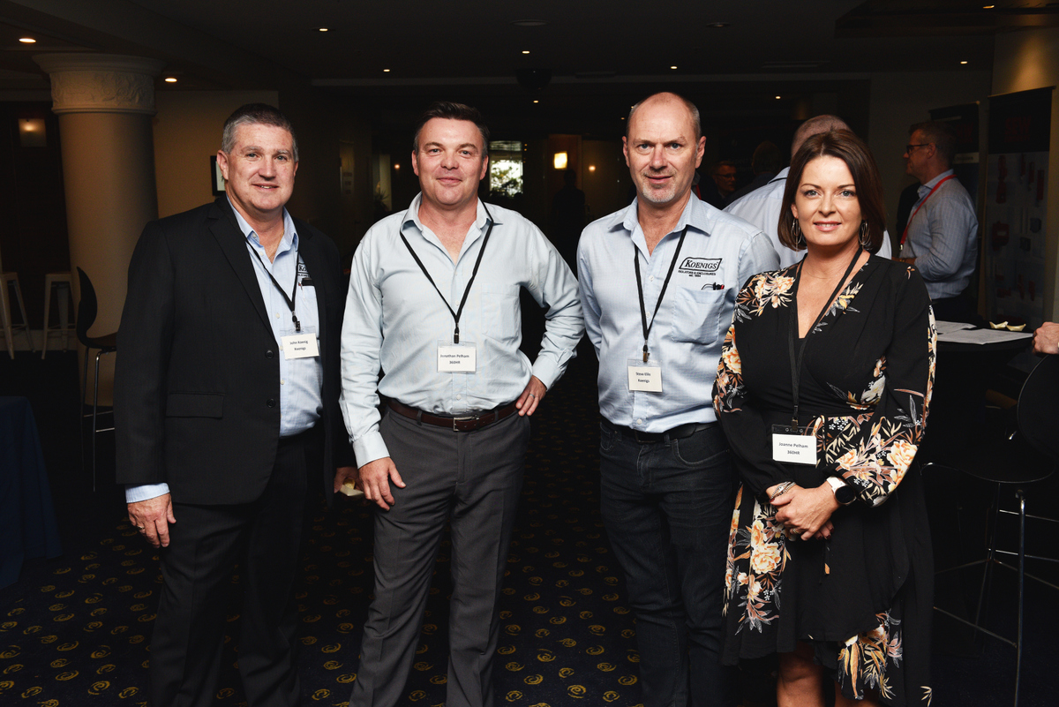
Sponsor the VIP cocktail hour
New to the 2022 event program bringing key delegates, sponsors and i3net Board together in a private setting. Benefits
2 x conference registrations (includes tickets to VIP Cocktail hour, Conference Dinner and Breakfast event)
1 banner (to be supplied by sponsor) on stage during Dinner and Breakfast events (type and size of banner to be determined by i3net).
Logo on holding slide prior to sessions
Logo on inside cover of conference booklet
Profile on conference website and printed program.
Investment
$3,000.

Slide 16
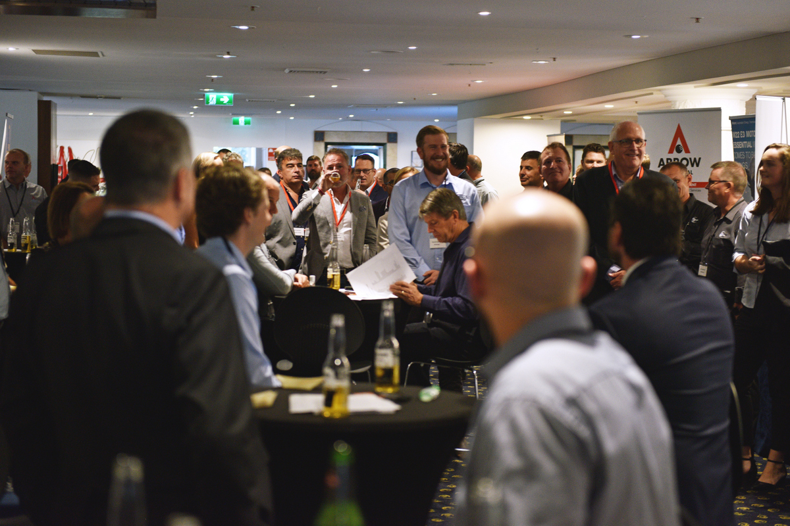
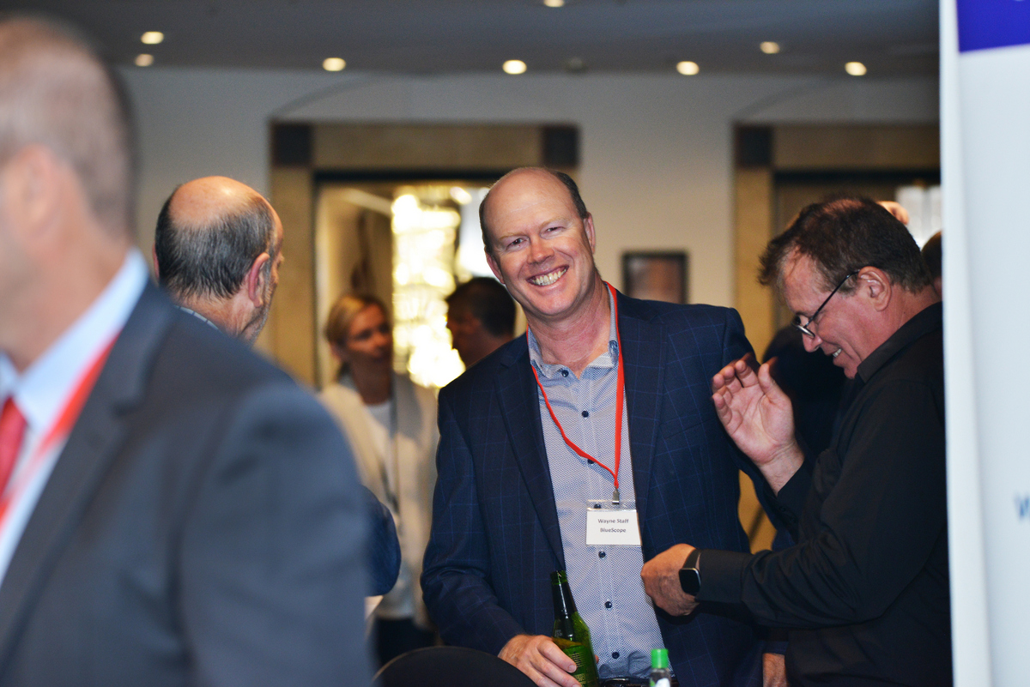
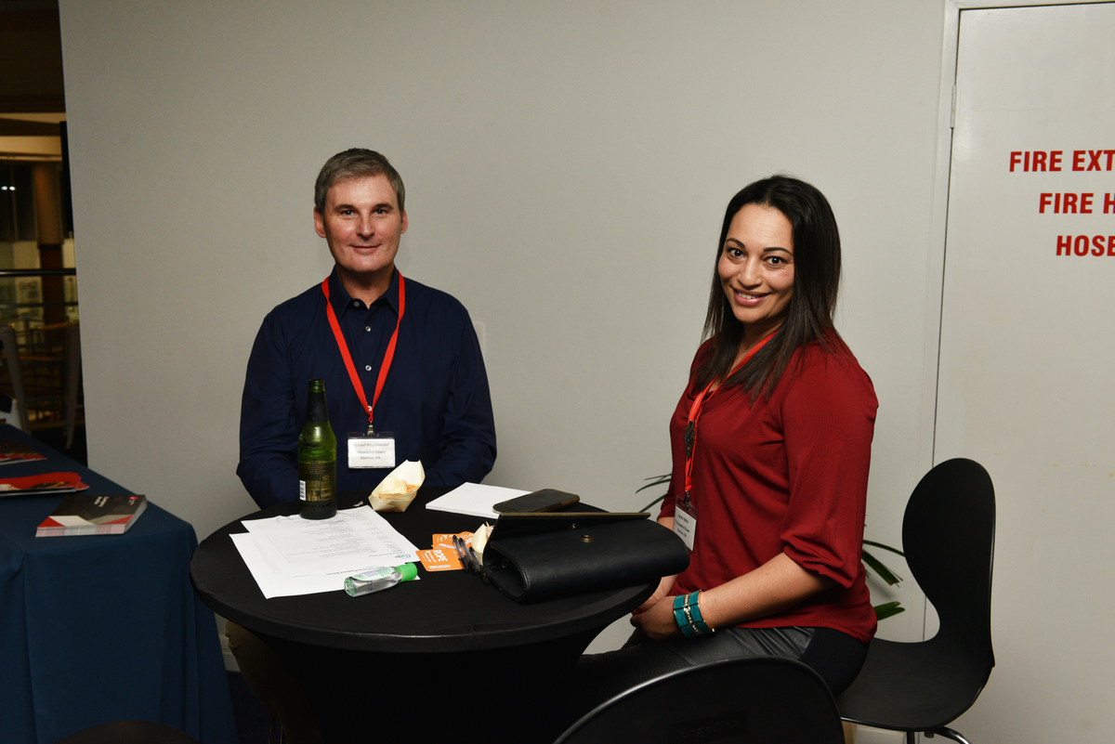
Sponsor the Speed Networking Session
New to the 2022 event program connecting key delegates and i3net members together Benefits
2 x conference registrations (includes tickets to VIP Cocktail hour, Conference Dinner and Breakfast event)
1 banner (to be supplied by sponsor) on stage during Dinner and Breakfast events (type and size of banner to be determined by i3net).
Logo on holding slide prior to sessions
Logo on inside cover of conference booklet
Profile on conference website and printed program.
Investment
$3,000.

Slide 17
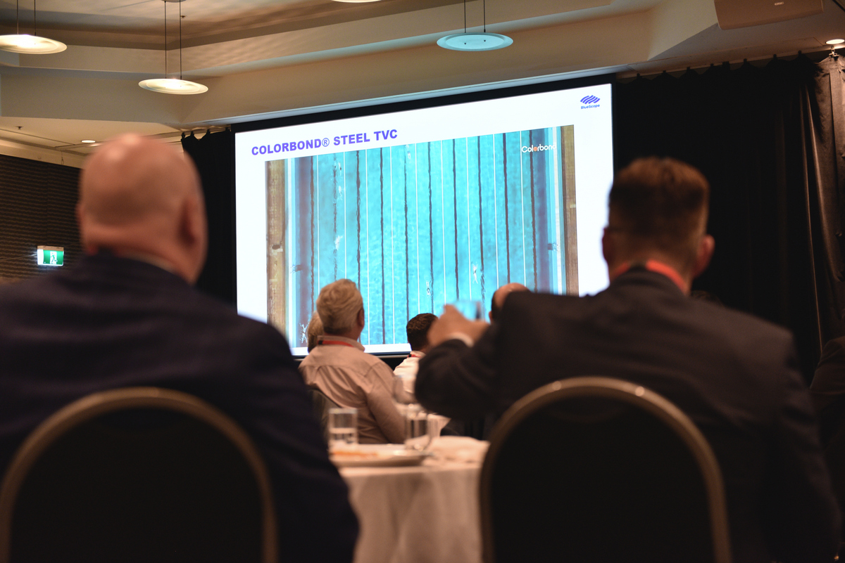
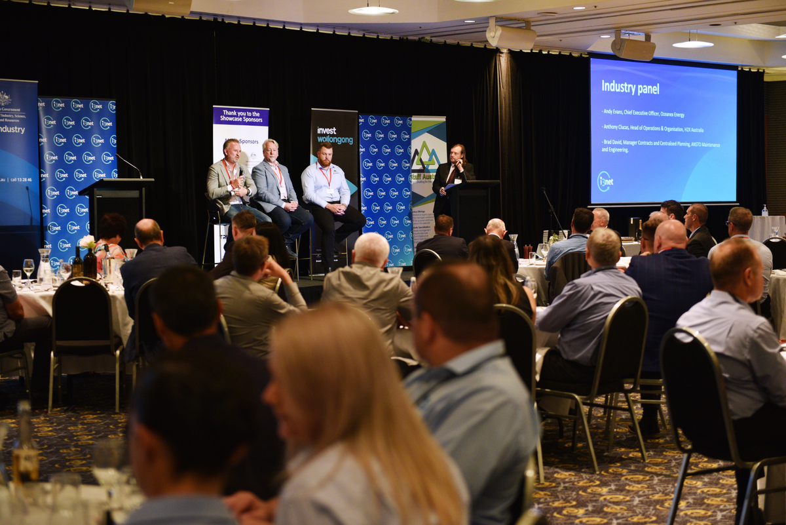
Secure your Table Dinner and Breakfast!
Get in early and book a company table! Benefits
10 x dinner registrations
10 x breakfast registrations
1 banner (to be supplied by sponsor) on stage during Dinner and Breakfast events (type and size of banner to be determined by i3net).
BONUS: 2 x tickets to VIP Cocktail Hour
Investment
$2,200.

Slide 18
Why be a part of the Illawarra Industry Showcase?
“The Showcase is the premier Illawarra networking event for industry-based companies. You know what it’s like when you’re so busy working in the business you never seem to find the time to look for new markets, connect with new people or retain those key relationships? Well at i3net we resolve this by holding the Showcase. At the event real business opportunities are presented, we introduce you to the right people and give you plenty of time to re-connect with old & new contacts. So by attending the Showcase, you can set your business up for 2022 and beyond.
I look forward to meeting you at the event.”
Bianca Perry, CEO, i3net.

Slide 19
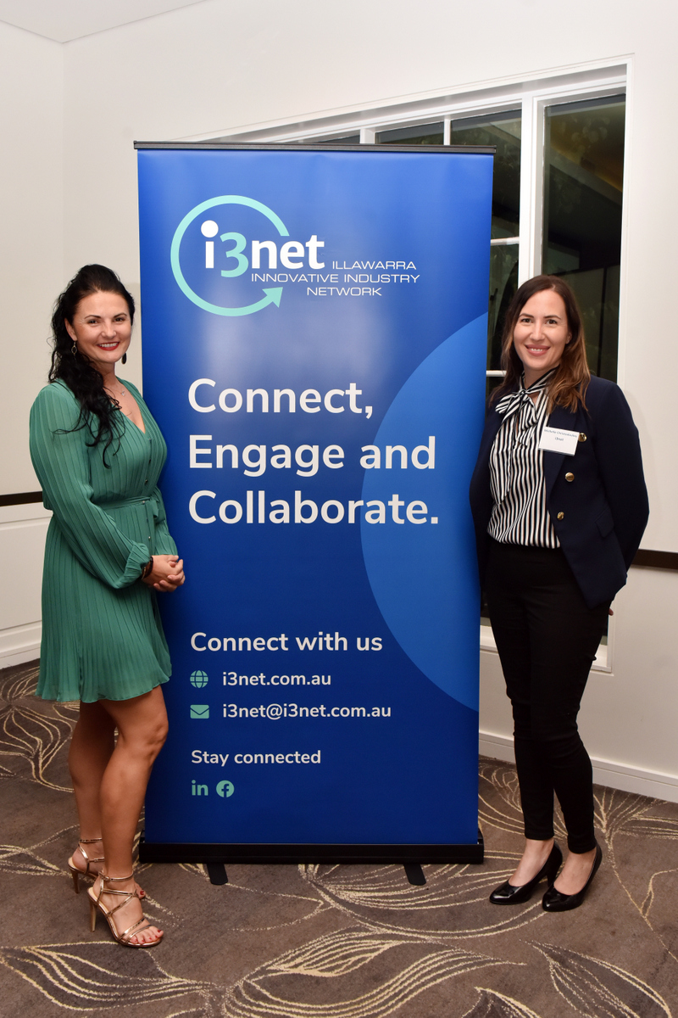
Contact i3net to discuss the best package to achieve strong ROI for your business.
Bianca Perry
Chief Executive Officer, i3net
M: 0401 030 023
E: bianca@i3net.com.au
Michelle Christodoulou
Manager, Communications, Operations & Events, i3net
M: 0439 625 620
E: michelle@i3net.com.au

