Slide 1
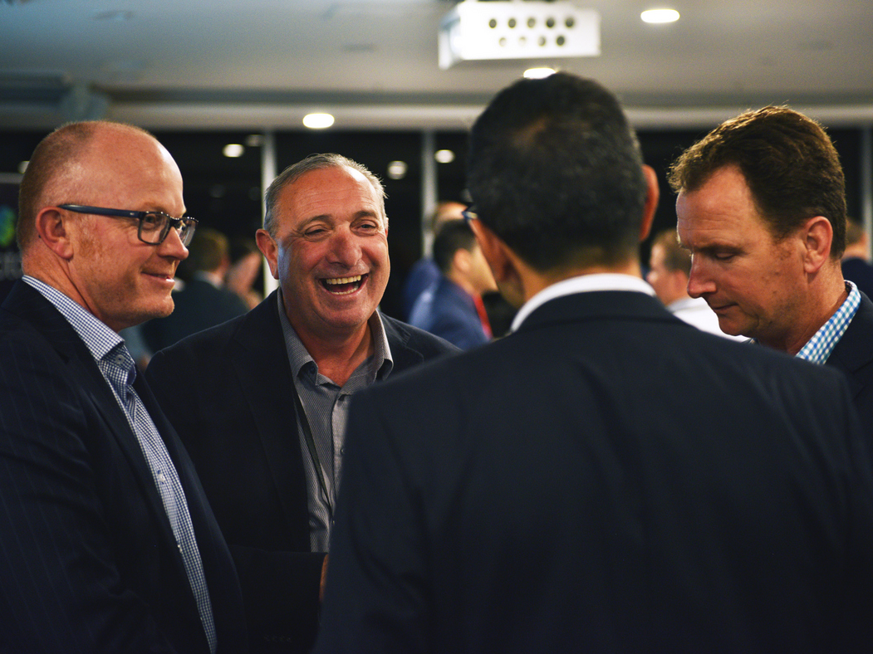

2021 Illawarra Industry Showcase
Sponsorship Proposal

Slide 2
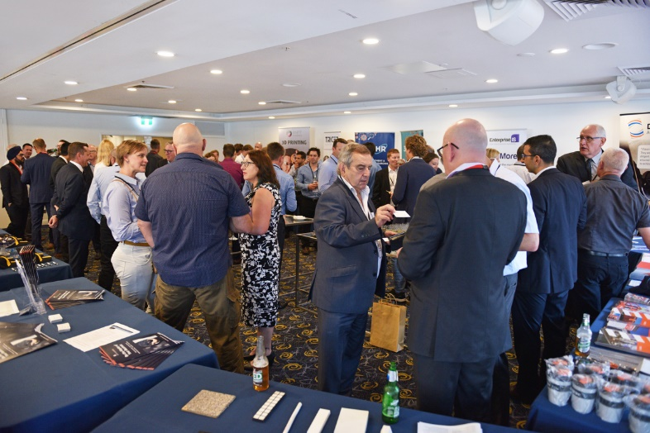
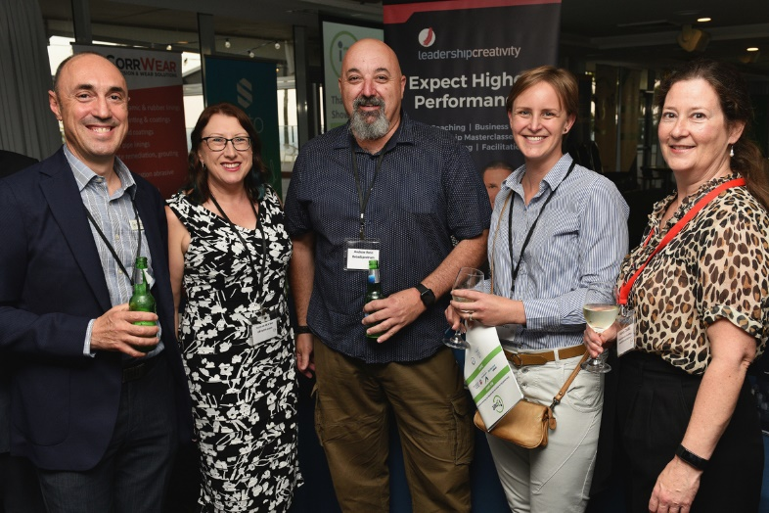
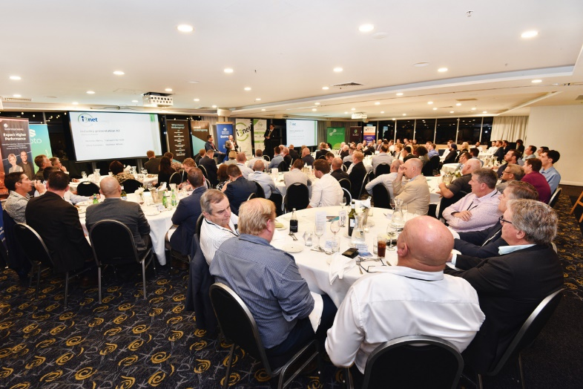

2021 Showcase Overview
Who attends?
Over 100 Industry leaders from across the country and the Illawarra are set to attend this event.
What happens at the event?
Speakers and panellists from Manufacturing, Mining, Energy, Gas, Recycling, Wind, Space, Rail, Defence and Infrastructure Sectors will take the stage, be at your table and in the room ready to hear from you.
You will have meaningful conversations and connections with key decision makers over a drink and a meal.
Schedule
Showcase dinner
Showcase breakfast.

Slide 3
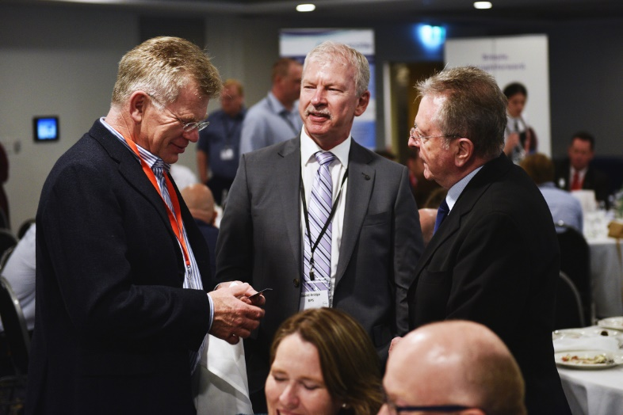
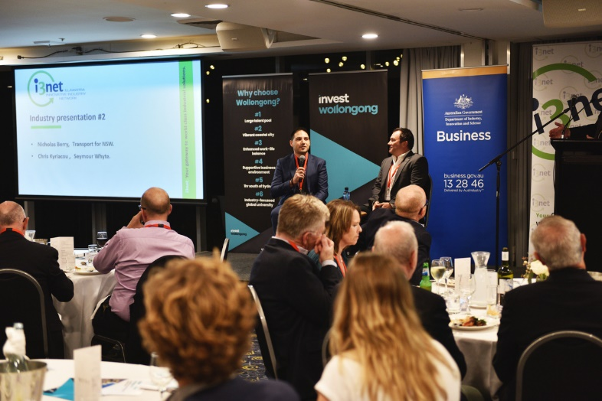
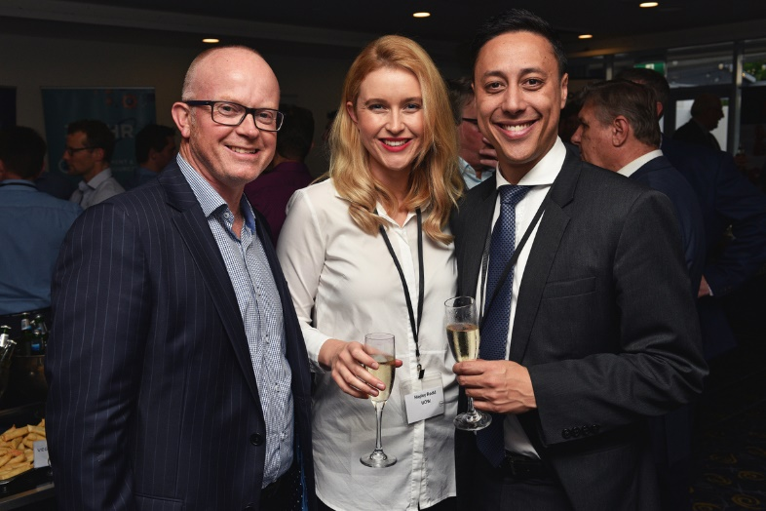
About i3net
i3net, the Illawarra Innovative Industry Network, is a network of industry based companies working from the Illawarra.
From bolts to blast furnaces, i3net provides access to the Illawarra’s vast range of manufacturers, engineering service providers and industrial suppliers.
The network was established over 18 years ago to promote the collective capability of industry to local, national and international markets.
The power behind the network is the depth of capability and skills that can be provided by one powerful industry resource.
You can find out more about i3net here: http://i3net.com.au/

Slide 4

Showcase dinner sponsor
Huge brand visibility!
Benefits
4 x conference registrations (includes tickets to Networking Reception, Conference Dinner and Breakfast event).
VIP seating during dinner event.
Acknowledgment in conference opening session
Option for Sponsor to give vote of thanks at the end of the event.
1 banner (to be supplied by sponsor) on stage during event (type and size of banner to be determined by Conference Secretariat).
Logo on holding slide prior to sessions.
Logo on inside cover of printed program.
200-word profile on conference website and printed program.
List of all registered delegates provided to sponsor at conclusion of conference, subject to Privacy Act conditions.
Investment
Only $10,000.

Slide 5
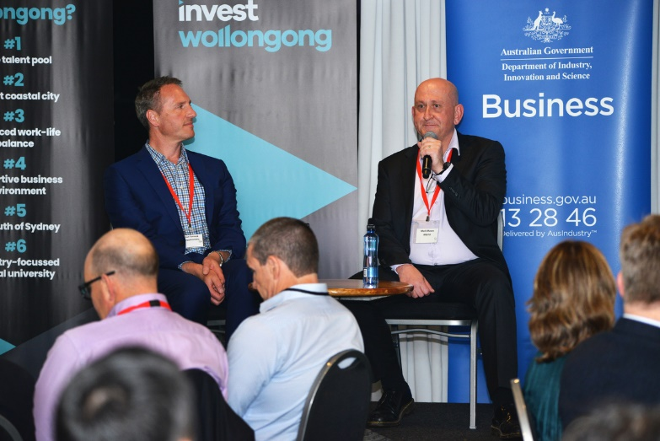

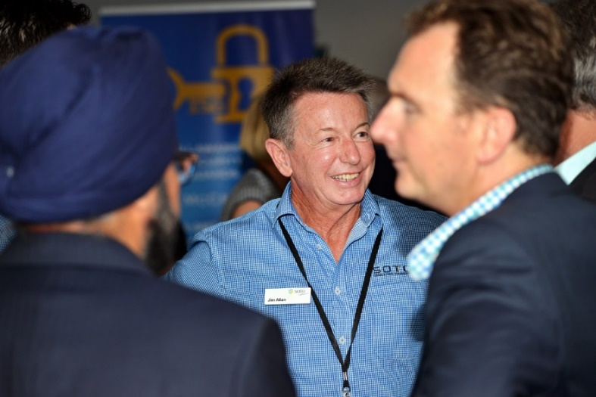

Showcase breakfast sponsor
Huge brand visibility!
Benefits
4 x event wide conference registrations.
VIP seating during breakfast event.
Acknowledgment in conference opening session.
1 banner (to be supplied by sponsor) on stage during event (type and size of banner to be determined by Conference Secretariat).
Choice of First or Last lightening presentation.
Logo on holding slide prior to sessions.
Logo on inside cover of printed program.
200-word profile on conference website .
List of all registered delegates provided to sponsor at conclusion of conference, subject to Privacy Act conditions.
Investment
Only $6,000

Slide 6


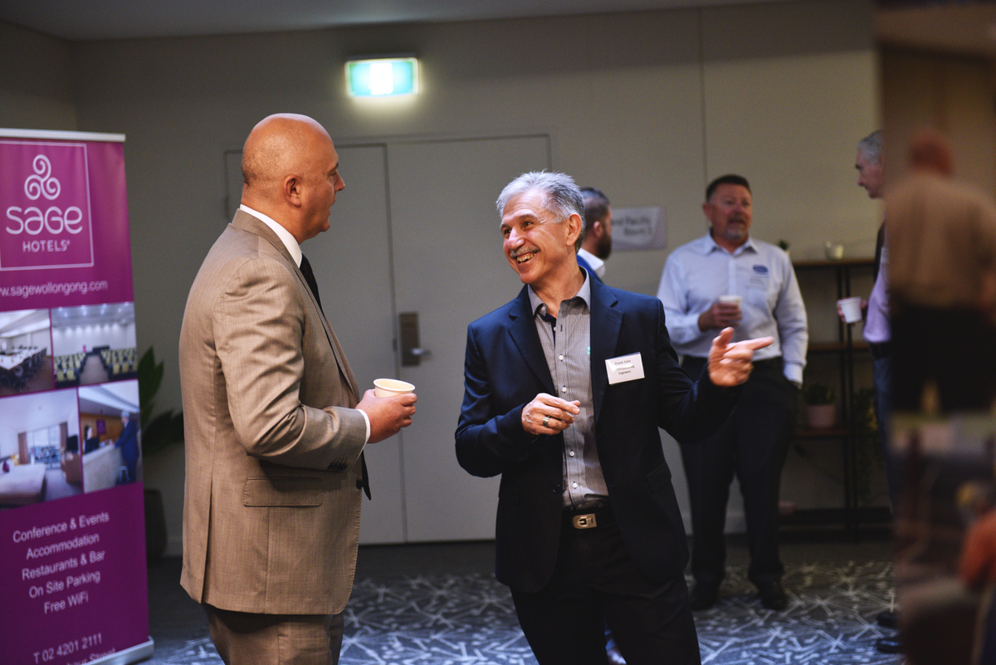
Water bottle partner
Crowd favorite! Fantastic visibility.
Benefits
Option to provide branded water bottles for the event. Bottles to be provided by to be provided by sponsor.
Water bottles will be placed at each table setting for the dinner and breakfast event.
2 Showcase Dinner and Breakfast conference registrations.
Organisation logo on conference website.
Logo on inside cover of printed program.
Logo on sponsor banner.
Investment
Only $2,500
Only 1 partnership available.
Will sell quickly!

Slide 7

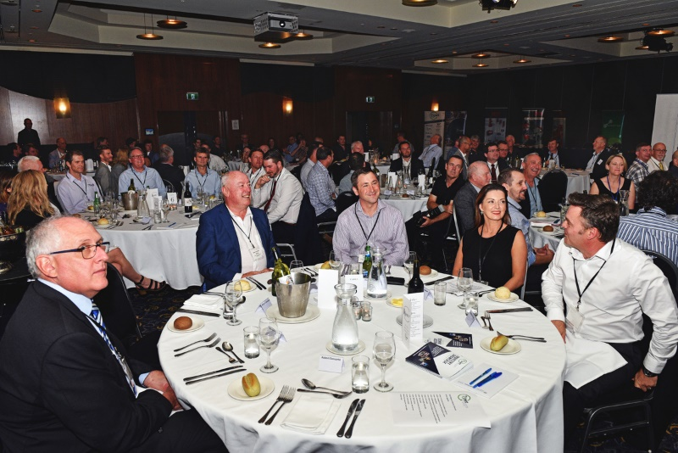
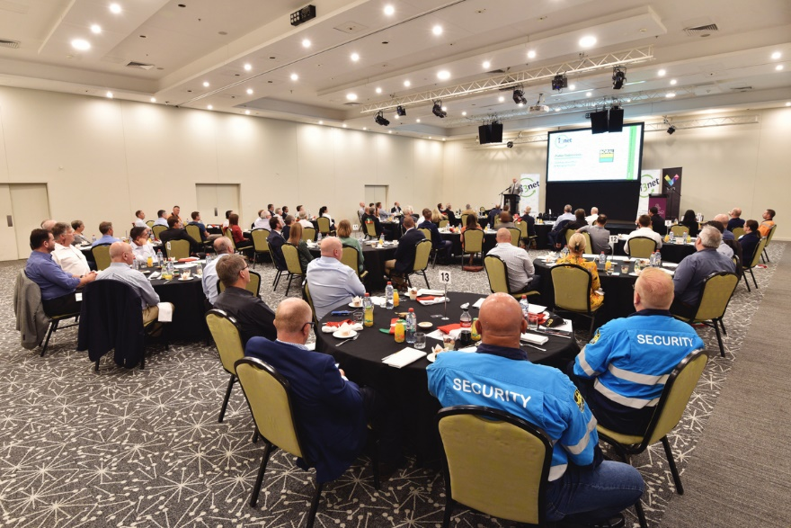
WIFI Partner
Crowd favorite! Fantastic visibility.
Benefits
• Exclusive sponsorship, one package only.
• Card at every seat with listing WIFI access information on one side and the sponsor’s logo and contact details on the other.
• Details displayed in the Dinner and Breakfast slide deck.
• Choice of WIFI password.
• Logo in printed program.
• Logo on conference website.
Investment
Only $2,500
Only 1 partnership available.
Will sell quickly!

Slide 8

Delegate bag
Crowd favorite! Fantastic visibility.
Benefits
Exclusive sponsorship of conference bag
Option to provide branded delegate bags for the event. Bags to be provided by to be provided by sponsor.
Bags can be pre-filled with 4 of your items
2 Showcase Dinner and Breakfast conference registrations.
Organisation logo on conference website.
Logo on inside cover of printed program.
Logo on sponsor banner.
Investment
Only $2,500
Only 1 partnership available.
Will sell quickly!

Slide 9
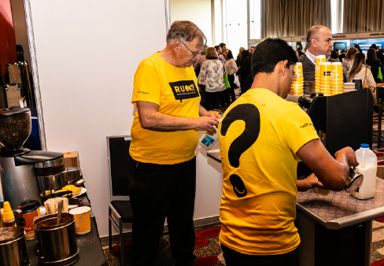



Barista coffee cart - SOLD!
Crowd favorite! Highly visited. Fantastic visibility.
Benefits
Exclusive partner, one package only.
Option to brand the coffee cart and surrounding area (coffee cups, signage, table cloths etc.) To be provided by to be provided by sponsor).
Option to provide barista apparel (apron, cap, shirt). to be provided by sponsor).
1 table set-up next to cart to display your company information, offers, attendee gifts etc.
2 Showcase Dinner and Breakfast conference registrations.
Organisation logo on conference website.
Logo on inside cover of printed program.
Logo on sponsor banner.
Investment
Only $5,000
Only 1 partnership available.
Will sell quickly!

Slide 10
Showcase sponsorship
Huge brand visibility!
Benefits
2 x conference registrations (includes tickets to Networking Reception, Conference Dinner and Breakfast event).
Front row seating during dinner event.
Acknowledgment in conference opening session
1 banner (to be supplied by sponsor) on stage during Dinner and Breakfast events (type and size of banner to be determined by Conference Secretariat).
Logo on holding slide prior to sessions.
Logo on inside cover of printed program.
200-word profile on conference website and printed program.
Investment
Only $1,500.
Popular option due to high visibility.

Slide 11
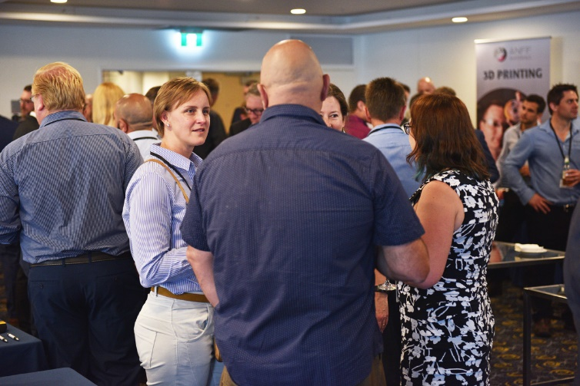
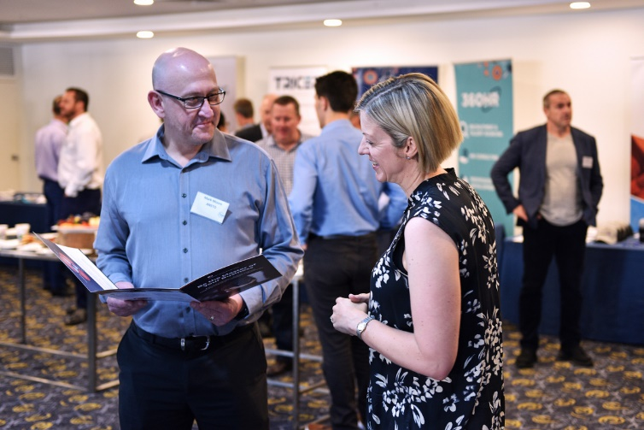


Premium expo position
Note: This offer is only available to i3net members and partners.
Benefits
Double length expo position
Huge brand visibility
Only two premium expo positions available.
Investment
Only $1000

Slide 12

Why be a part of the Illawarra Industry Showcase?
“Essentially the Showcase is the premier Illawarra networking event for industry-based companies.
You know what it’s like when you’re so busy working in the business you never seem to find the time to look for new markets, connect with new people or retain those key relationships? Well at i3net we resolve this by holding the Showcase.
At the event real business opportunities are presented, we introduce you to the right people and give you plenty of time to re-connect with old & new contacts.
So by attending the Showcase, you can end the calendar year on a high, and set your business up for 2021 and beyond.”
Bianca Perry, CEO, i3net.

Slide 13
Contact i3net today and speak with our CEO
Bianca Perry
Chief Executive Officer, i3net
M: 0401 030 023
E: i3net@i3net.com.au
W: www.i3net.com.au
The link between your business and Illawarra Industry
Note: This sponsorship document is subject to change.
Please contact CEO Bianca Perry for the most up to date version.

